Slide 1
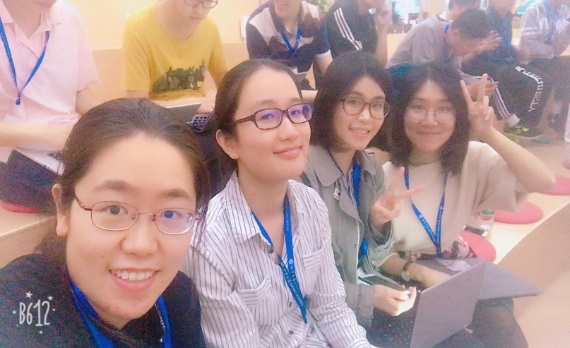
Naomi’s
HACKPKU DAY
Yang Saboya
Xu Yue
Fan Zhiwei
Ni Liao

Slide 2
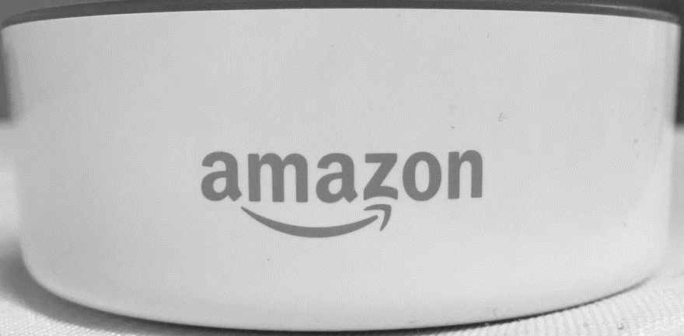
SafeKeeper
Always Keep Your Safety in Mind !

Slide 3
Background - Solitary
Globally
1996 → 2006
153 → 202 millions
+33%
In China
1990 → 2013
6% → 14.6%
Notes:
据市场分析公司欧睿信息咨询公司数据统计，全球独居人数已由1996年的153百万攀升至2006年的202百万人——十年间增加了33%。
根据国家民政部统计，全国独居人口从1990年的6%上升到2013年的14.6%，单身独居群体日益庞大。

Slide 4
Background – Safety and Care
Notes:
对安全的需求；被牵挂的渴望；独居也想要有晚归有人牵挂的幸福感

Slide 5
Leave Home
Alexa, Open SafeKeeper, I‘m leaving.
Naomi, have a nice day and see you.
Set two events on Naomi’s calendar:
Remind Naomi
Inform Emergency Contact

Slide 6
Arrive Home in Time
Alexa, Open SafeKeeper, I‘m home.
Naomi, welcome home.
Cancel two events on Naomi’s calendar:
Remind Naomi
Inform Emergency Contact

Slide 7
Arrive Home not in Time
Message
Disable
Message

Slide 8
Technologies and APIs
Amazon Echo Dot
AWS Lambda
Google Calendar APIs
Flask-Ask Alexa skills kit development framework for amazon echo devices with python
NGROK
GitHub : https://github.com/yangsaboya/SafeKeeper-

Slide 9


